Slide 1


TSIC
TELANGANA STATE INNOVATION CELL
WALL-MOUNTED SMART FAUCETS
BY TEAM : BLUE WAVE

Slide 2
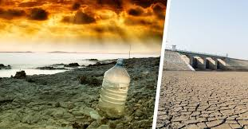
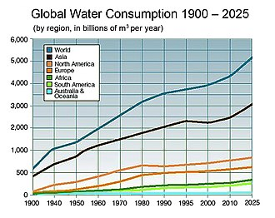
THE BEGINNING
Four billion people — almost two thirds of the world's population — experience severe water scarcity for at least one month each year
Over two billion people live in countries where water supply is inadequate. Half of the world's population could be living in areas facing water scarcity by as early as 2025.

Slide 3

WHAT TO DO?
“WE NEED TO CONSERVE WATER AND PROTECT OUR UPCOMING GENERATIONS”

Slide 4
HOW DO WE DO THAT???

Slide 5
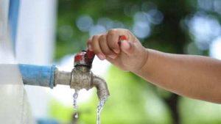
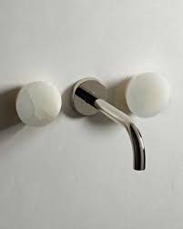
IDEA

Slide 6
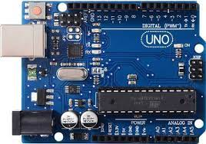
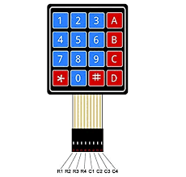
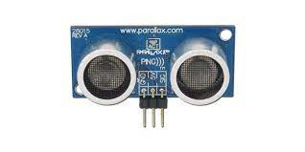
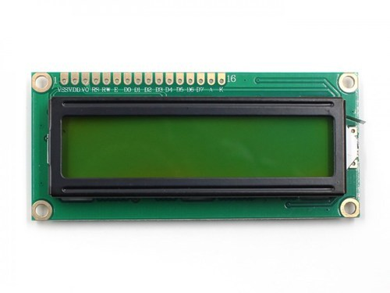
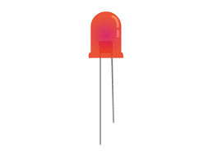
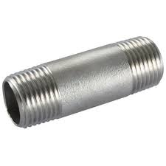
COMPONENTS
ULTRASONIC DISTANCE SENSOR
ARDUINO UNO R3
4x4 KEYPAD
LCD 16x2
LED
METALLIC SCREW

Slide 7
IDEA DESIGN
When the valve is opened:
BEHIND THE WALL
DIGITAL METER
ULTRASONIC SENSOR
Faucet
DC MOTOR
METALLIC SCREW
LED indicator

Slide 8
When the valve is closed:
BEHIND THE WALL
DIGITAL METER
ULTRASONIC SENSOR
Faucet
DC MOTOR
LED indicator
METALLIC SCREW

Slide 9
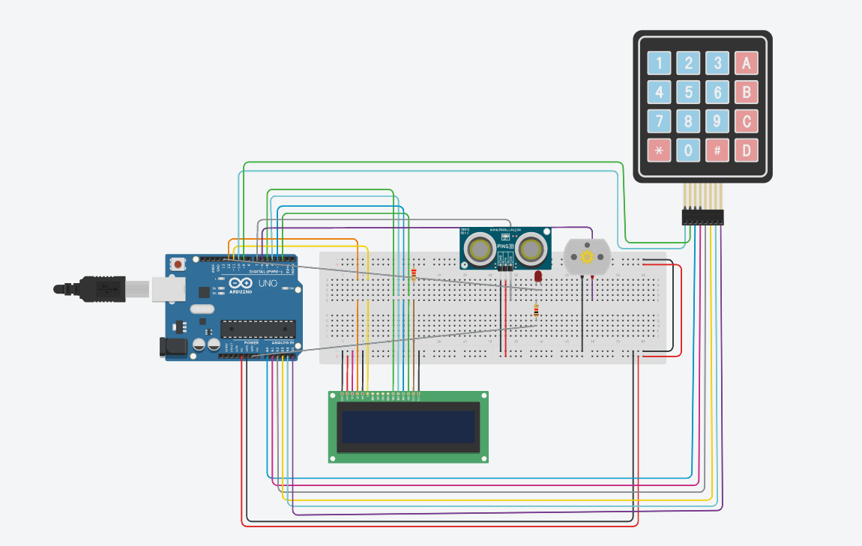
CIRCUIT DIAGRAM OF THE SMART FAUCET

Slide 10
PERKS
This device helps in controlling the flow of the water.
The one who uses this device will be contributing towards the conservation of water.
This device can be included in the development of infrastructure.
Usually people fail to turn off the faucets but this device will help them by closing the faucet automatically after the required flow of water.

Slide 11
THE END.
THANK YOU!!
TEAM MEMBERS:
-VELLANKI MAHITADIVYA
-MUNAGALA NITYA JAHNAVI
-G.VARSHA REDDY
-MITUL RAJ

